Slide 1
Card Game WAR
ANUJ JOSHI
Notes:
Hello everyone,
Today, I would like to present my project on hosting the card game, War, on the cloud. The purpose of this project is to provide a scalable and reliable platform for players to enjoy this classic game without the need for physical cards or local servers.

Slide 2
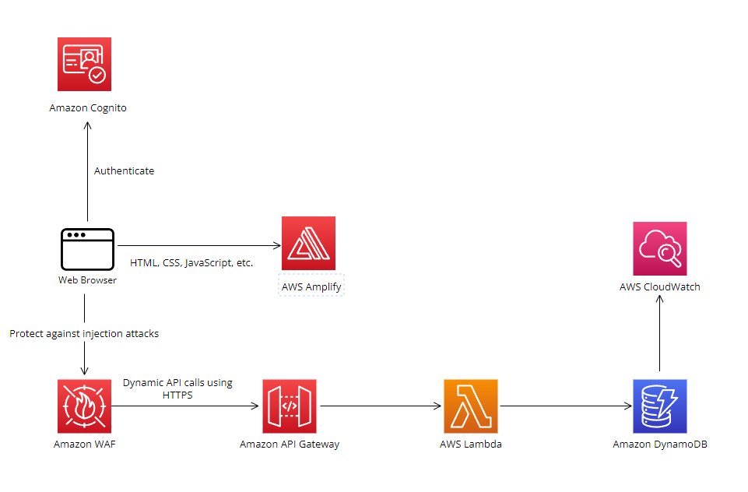
COMPONENTS
Notes:
Let's start with the architectural diagram showing the components and flow of events/data:
As you can see, the architecture consists of several components. Firstly, we have the clients, which can be either web or mobile applications that players use to interact with the game. Secondly, we have the game server, which handles the game logic, such as shuffling the cards, dealing them, and determining the winner of each round. Finally, we have the cloud infrastructure, which provides the necessary resources to run the game server and store game data.

Slide 3
Primary Approach to Architectural Pillars
Security
Using AWS Web Application Firewall, we can protect against SQL injection and cross-site scripting
Reliability
Using API Gateway, we can monitor and log API calls to provide reliability
Performance
Using AWS Lambda, we can implement functions to improve overall performance
Cost Optimization
Using AWS Cost Explorer, we can monitor cloud usage and analyze costs
Operational Excellence
Using CloudWatch, we can monitor the server’s performance and health
Notes:
Now, let's talk about how we plan to implement each of the 5 well-architected pillars:
Security:
top priority when hosting cloud application
many tools and services for security
key tool is AWS WAF, protect against
configuring rules filter traffic and block threats before reach game server
Reliability:
important aspect, ensure reliability and availability
API gateway makes it easy to create deploy manage api
tools for monitoring and logging api calls
monitor using cloudwatch and logs from api gateway, detect issues and take appropriate action
Performance:
lambda is a serverless service, host game server logic and improve performance
lambda function to shuffle deck, deal and determine winner, reduce burden on server, ensure fast gameplay
lambda functions and scalable and triggered automatically, large number of players can be handled
Cost Optimization:
managing costs important consideration when hosting on cloud, aws provides tools to optimize cloud spending
Cost explorer, cost management tool, monitor cloud usage and analyze costs
analyze usage patterns and identify areas to optimize costs, only pay for what we need
Operational Excellence:
cloudwatch, monitoring service, performance and health of game server and infrastructure
monitor key metrics, CPU usgae, mem usage, network traffic, detect issues that arise
set alarms and automated actions based on predefined metrics, ensure operational excellence

